Slide 1

Wrap up of Day 2
PRoNTo course
May 2021

Slide 2

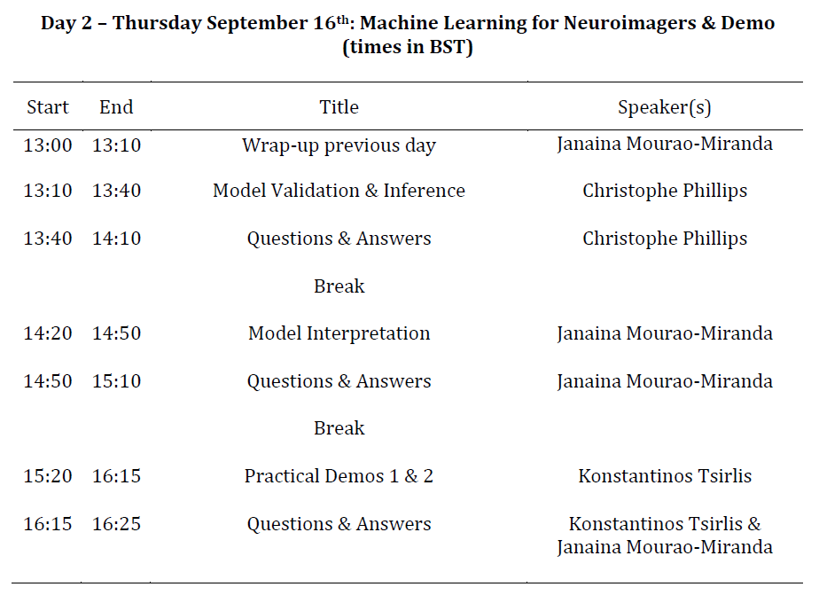

Slide 3
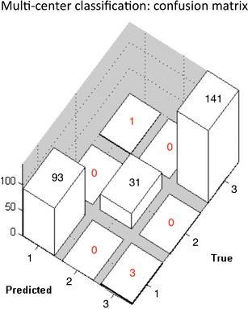
Classification & regression performance
Accuracy: total, per class, balanced
Sensitivity & specificity
ROC curve & AUC
Mean square error
Correlation of prediction with target

Slide 4
Cross-validation
samples
label
Variables:
 |  | var 1 | var 2 | var 3 | … | var m
1
2
3
…
i
i+1
i+2
…
n
1 |  |  |  |  | …
-1 |  |  |  |  | …
-1 |  |  |  |  | …
… |  | … | … | … |  | …
1 |  |  |  |  | …
1 |  |  |  |  | …
1 |  |  |  |  | …
… |  | … | … | … |  | …
-1 |  |  |  |  | …
Trained classifier
Training set
1
-1
…
-1
Test set
True label
Predicted label

Slide 5
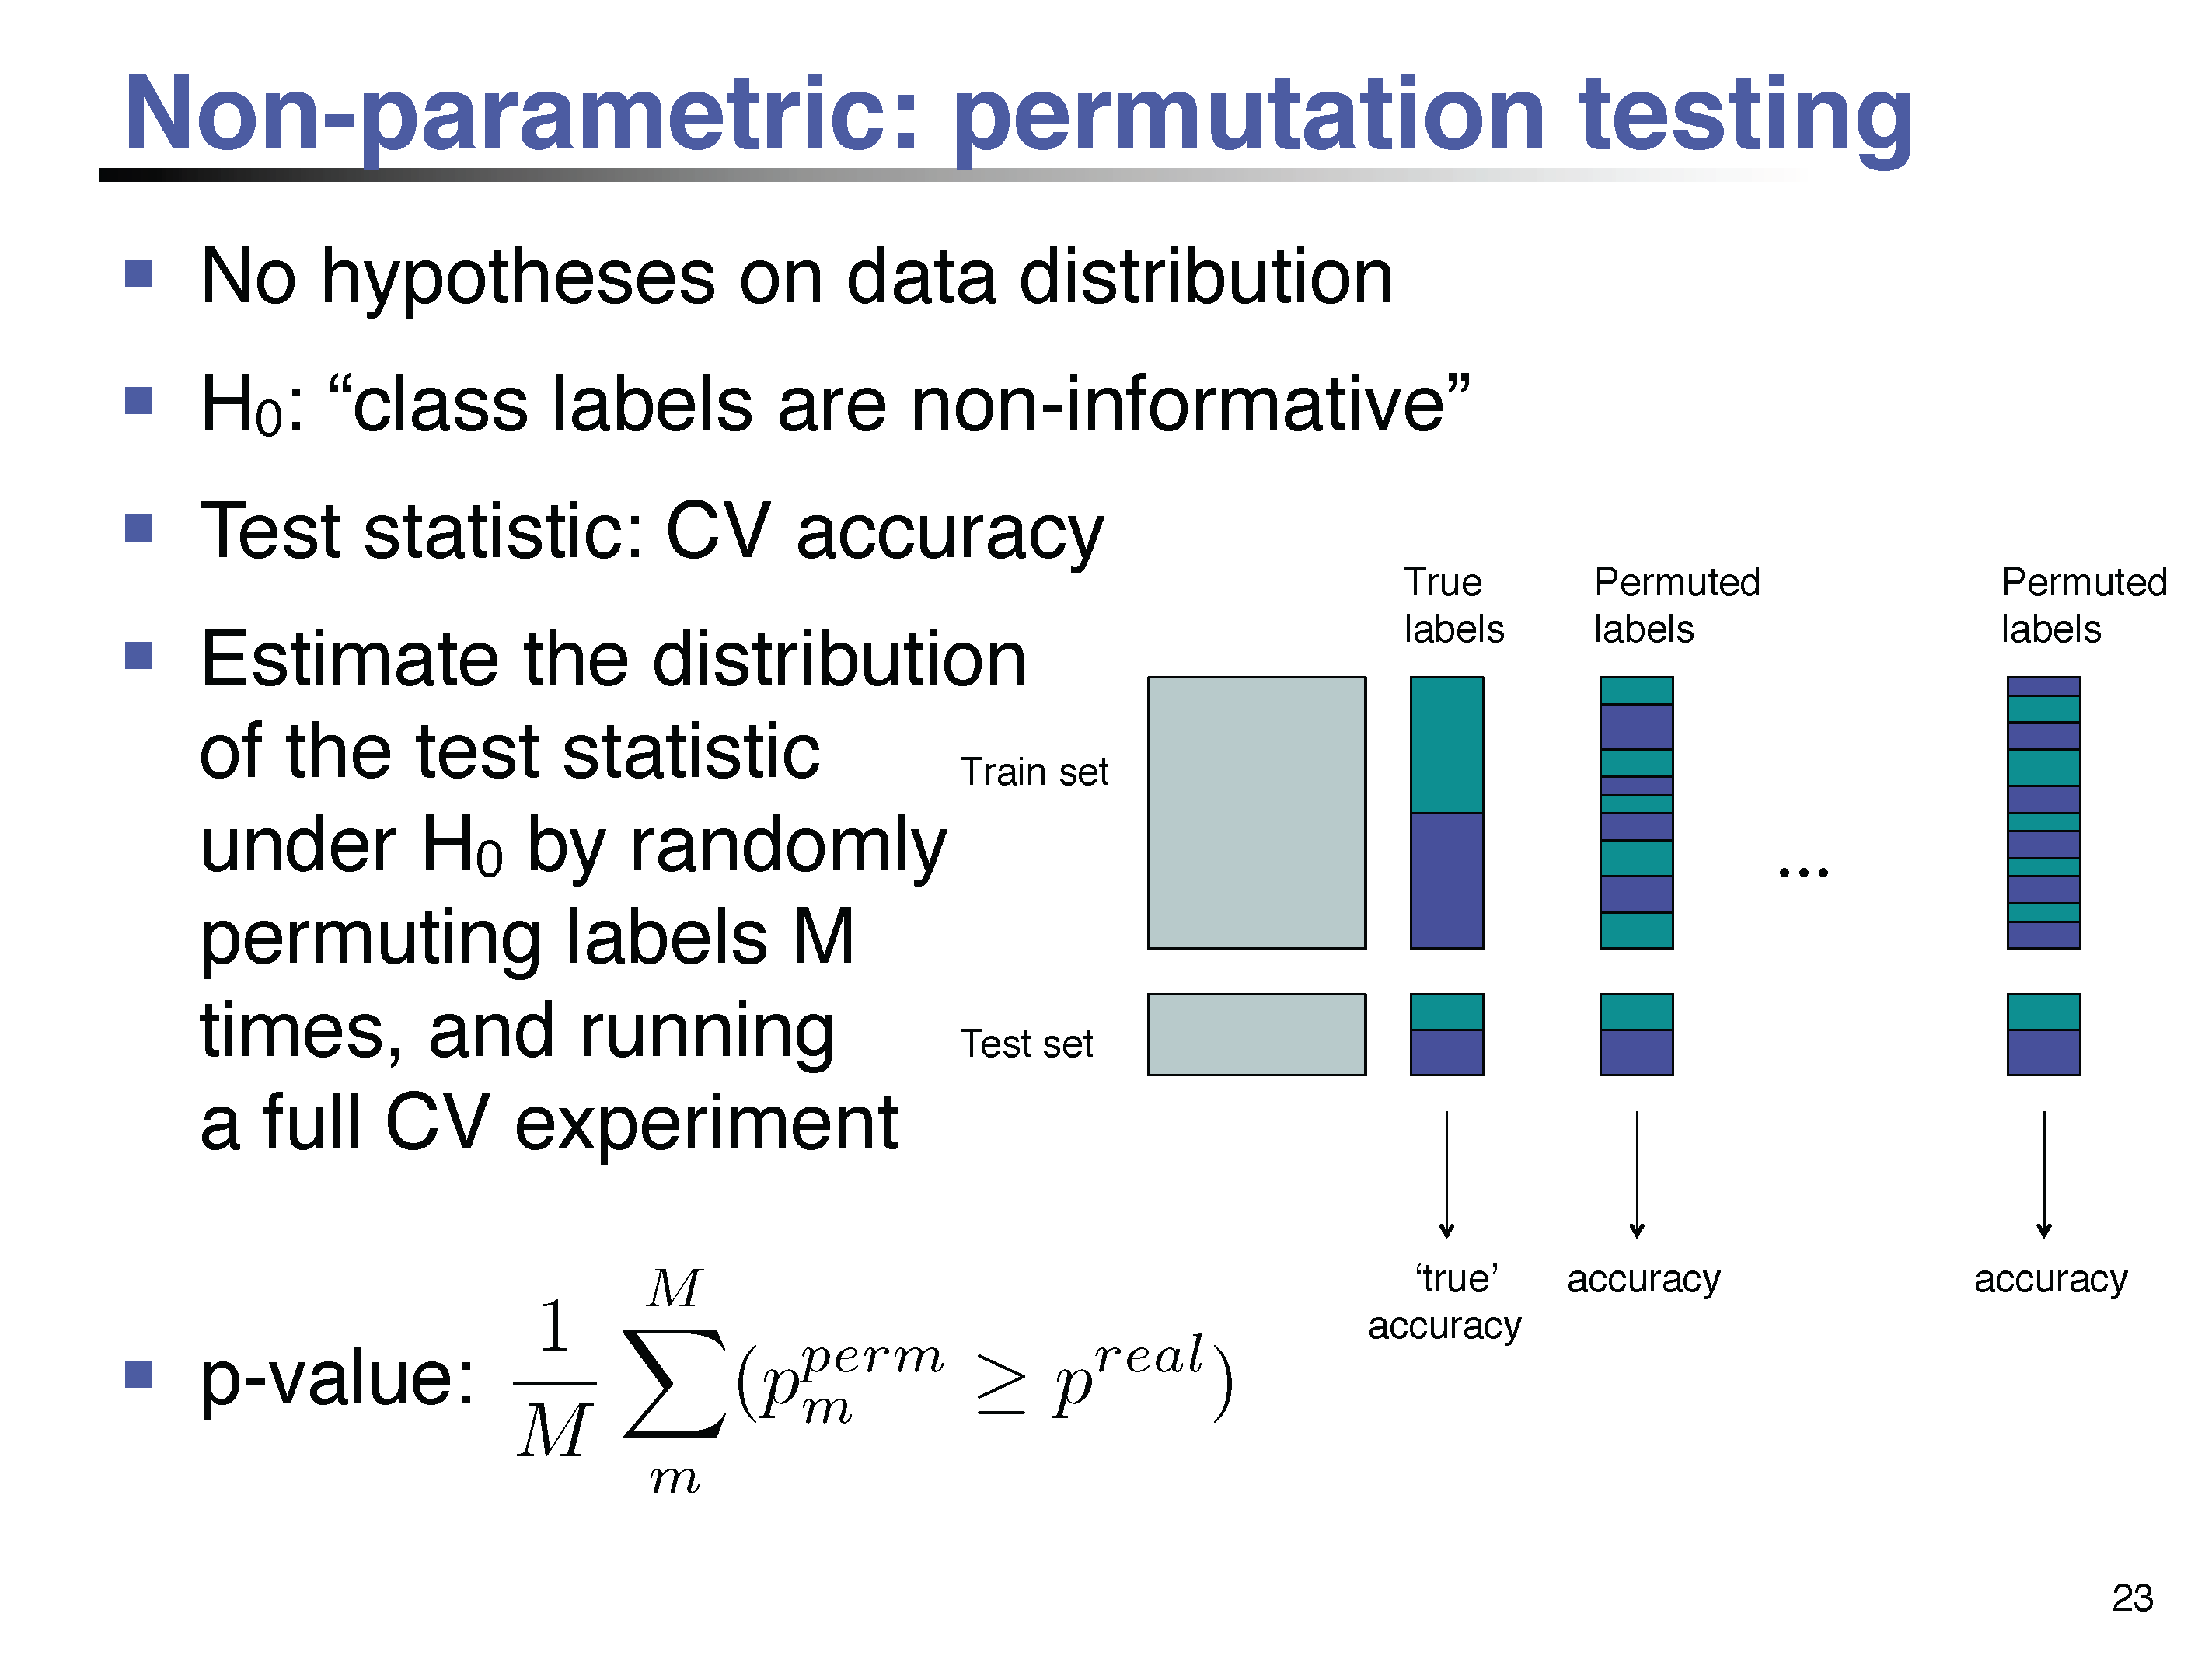
Inference

Slide 6
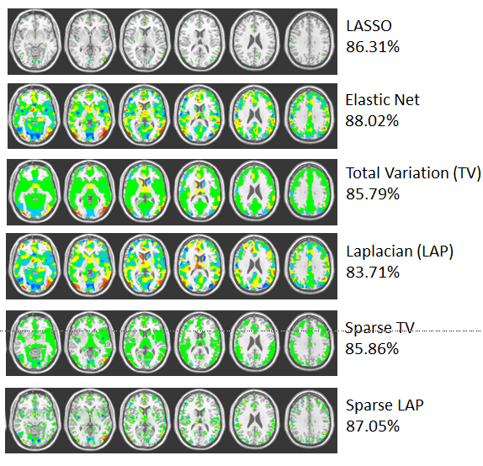
Different regularization on w

Slide 7
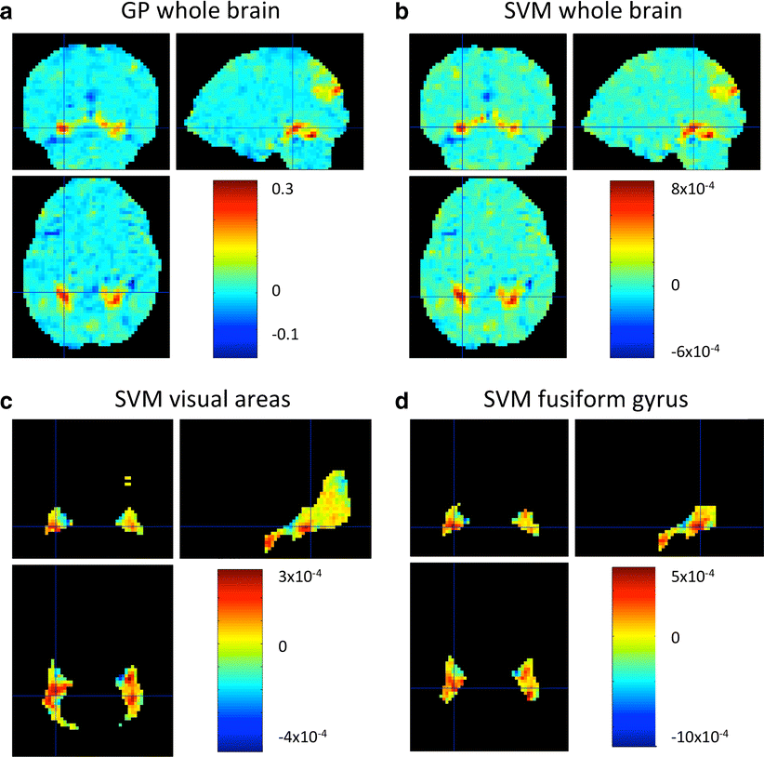
Weight maps

Slide 8
Demo 1 & 2
fMRI data → brain decoding
  Based on raw signal + design
  Using SVM
  Weight maps + post hoc summary
sMRI data → subject prediction
  Based on segmented images (GM maps)
  Using MKL with an atlas
  Region + voxel weights

Slide 9
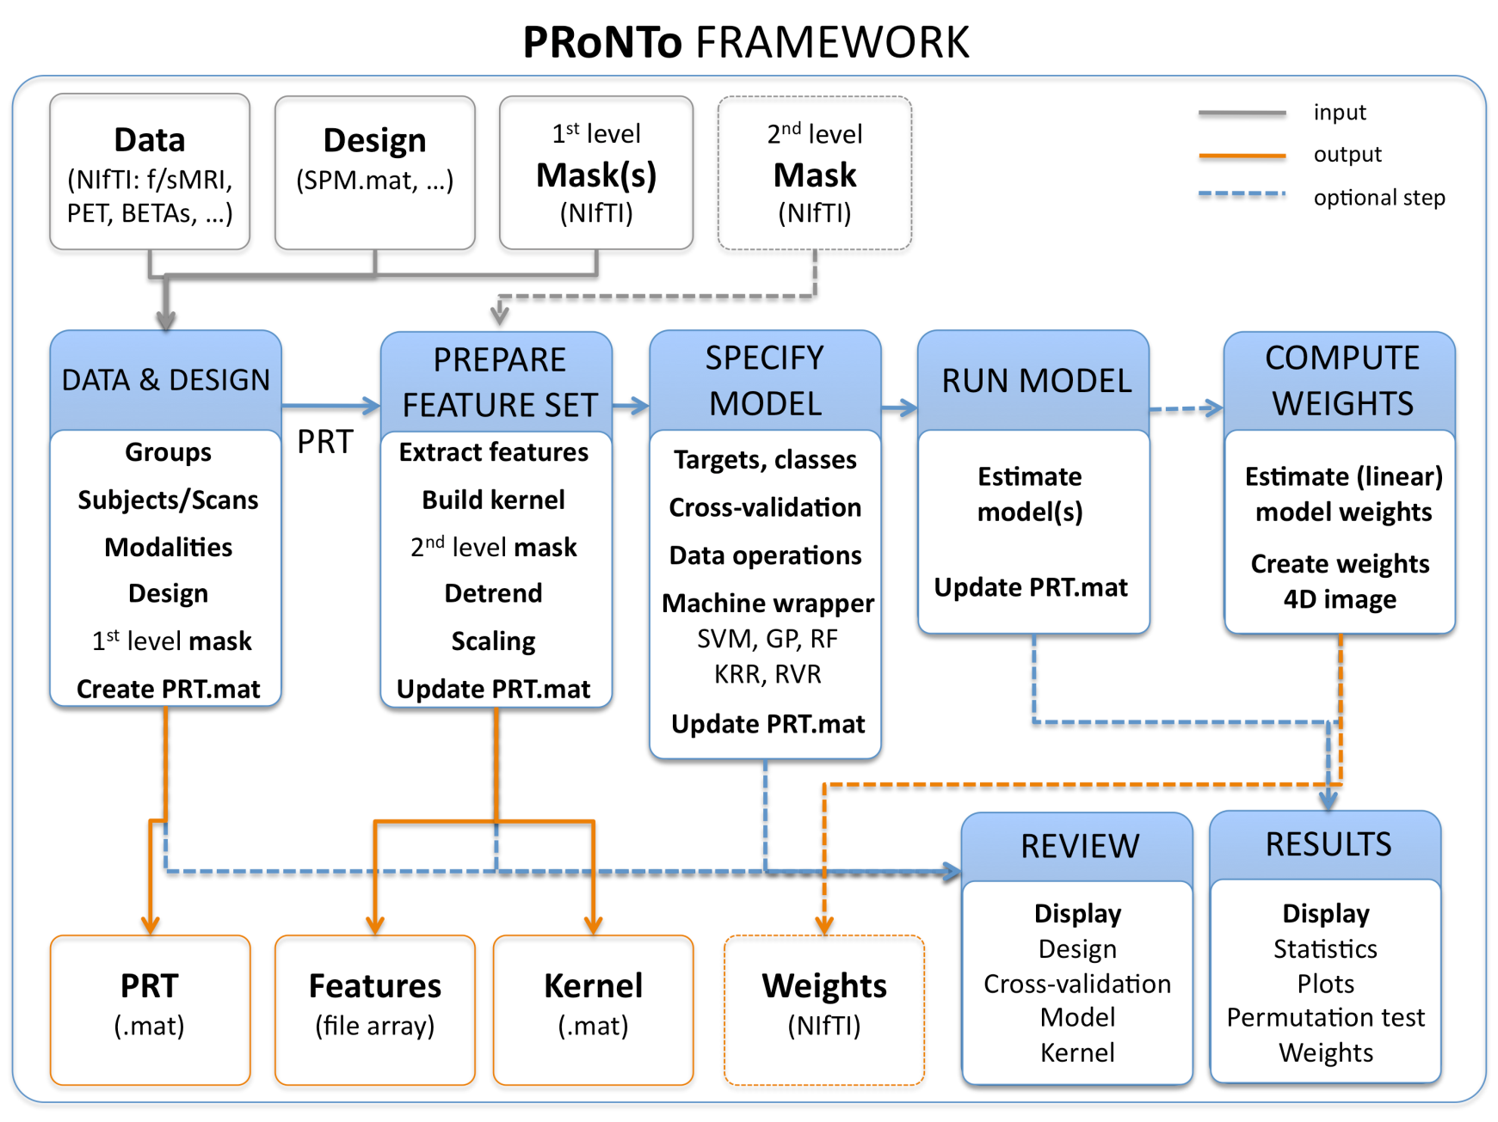
PRoNTo framework

Slide 10
